Slide 1
CS611 · ASSIGNMENT 2
End to End Machine Learning for Loan Default Prediction
From raw loan, customer and clickstream data to a monitored, governed model scoring new loans every month
PySpark medallion pipeline · XGBoost · SHAP · MLflow · Airflow · Docker
0.619
+0.077
70%
3 DAGs
PR-AUC on later, unseen loans
over the logistic baseline
of defaulters caught
data · training · inference
CS611 Assignment 2 · End to end machine learning for loan default prediction
1
Notes:
One deck for the whole project: the data and ML pipeline, the main design choices, the problems we hit and how they were solved, and the results on loans the model never saw.

Slide 2
The question: 30+ days past due by month 6?
Loan starts
score here, with data known that day
Six monthly instalments
repayment history builds up
Month 6: label
1 = 30+ days past due
Decision at application, outcome known 6 months later — so features must use only what was known on the start date, and performance can only be confirmed with a 6-month delay.
12,500
28.8%
0.619
70%
35%
loans, one per customer
4 raw sources, 378k rows
default rate
stable month to month
PR-AUC on later loans
baseline 0.542
of defaulters caught
precision 0.58
of new loans flagged
for review
Primary metric PR-AUC: defaulters are the minority; it rewards ranking them above good loans, unlike accuracy.
Proof on unseen data: the final model was tested once on loans that started after all training loans (out-of-time) — no drop from validation.
CS611 Assignment 2 · End to end machine learning for loan default prediction
2
Notes:
Prediction contract: one row per loan, scored at loan start, label = 30+ days past due at month-on-book 6. Everything else in the design follows from this timing.

Slide 3
Architecture: data, training and inference
4 raw sources
loans · attributes · financials · clickstream
Bronze
raw as-is, CSV, lineage
Silver
validated, cleaned, Parquet
Gold
feature store (as-of) + label store
DATA PIPELINE
monthly DAG
Split
train / validation / test + out-of-time
Features
OpenFE + model-specific filtering
Model development
LR · RF · XGB · SHAP · tuning
MLflow registry
@champion · @challenger
MODEL TRAINING
6-monthly / on demand
@champion
retrain trigger
Score new loans
Gold features + @champion
Predictions
monthly Parquet
Monitoring
drift now, performance +6 months
Governance
refit / rollback rules
INFERENCE
monthly DAG
Data contract (YAML)
Docker
Notebooks → modules
Evidence
sources, keys, label, allowed predictors
Jupyter + Airflow images, own pipeline env
developed in notebooks, run as util/*.py
reports, model cards, sign-off, logs
CS611 Assignment 2 · End to end machine learning for loan default prediction
3
Notes:
Data DAG builds one month of Bronze/Silver/Gold per run (back-filled from 2023-01). Training DAG validates the full history, splits, engineers features, trains and registers. Inference DAG scores each month's new loans with whatever @champion points to, monitors, and triggers retraining when the governance rules fire.

Slide 4
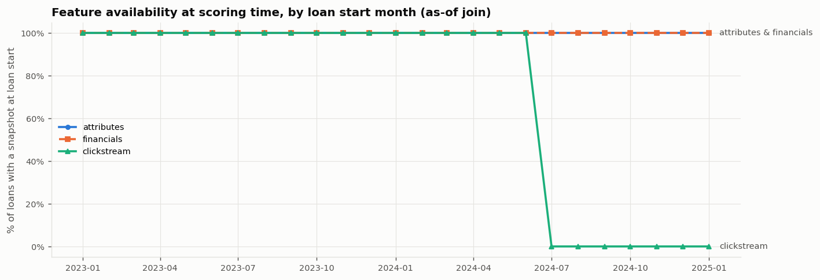
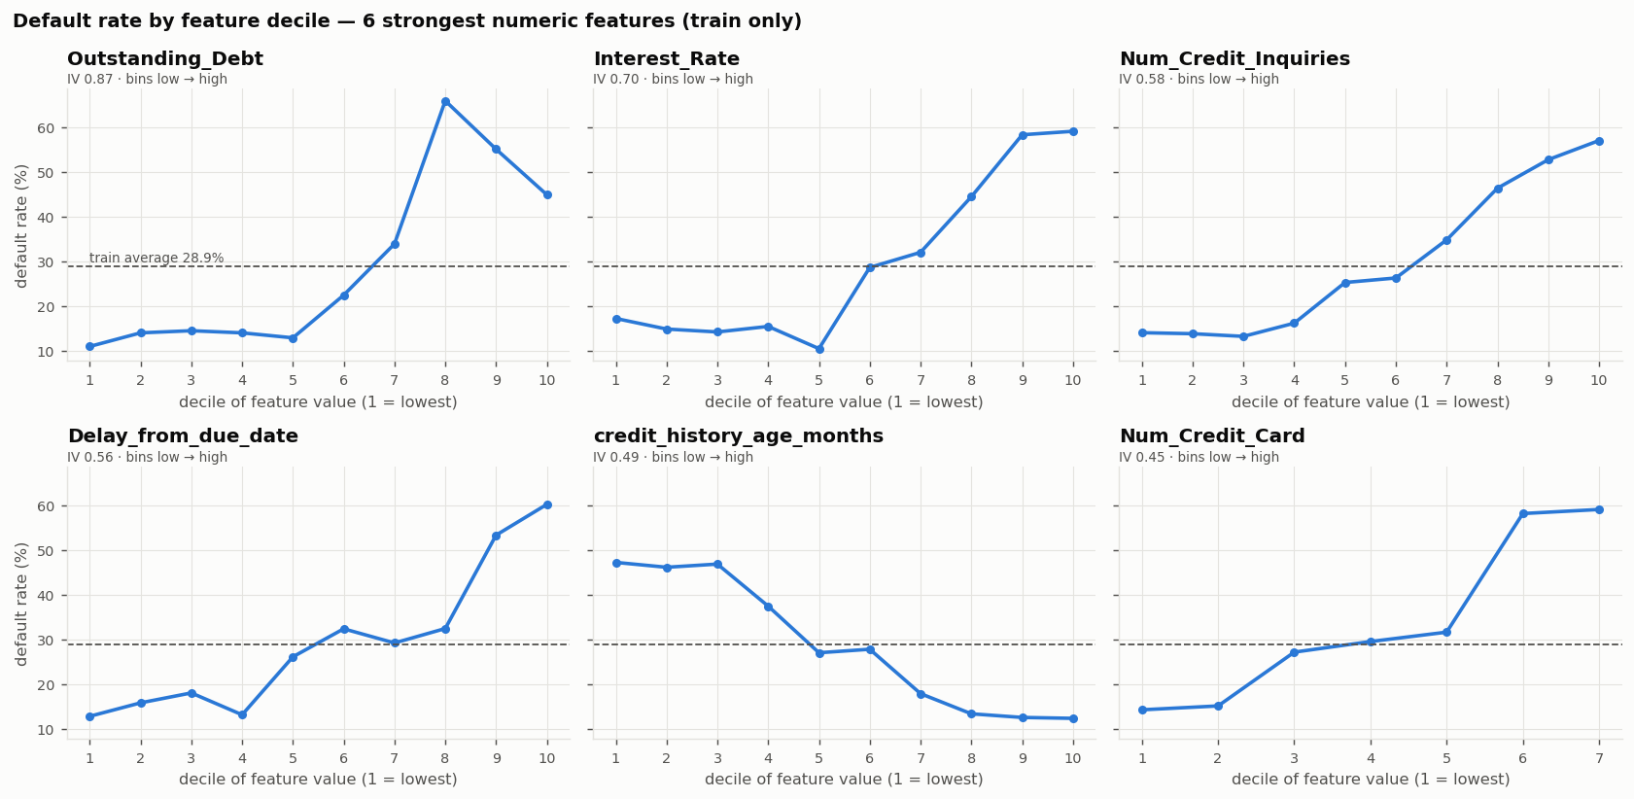
EDA: findings that shaped the design
FINDING → DESIGN CHOICE
Dirty raw values
placeholders ('_', NM, -100), underscores on numbers, impossible ages and counts
→ fix or null + flag (14 failing rules → 0); keep the row
Clickstream stops in 2024-06
chart above: 100% → 0% for later loans
→ two models: A without, B with clickstream; no 'has clickstream' flag (time proxy)
Strong, non-linear signal
debt, interest rate, inquiries, delays; steps and rise-then-fall (chart below)
→ tree models; ratio / product features
Stable target
default rate 23–35% per month, no trend
→ random stratified split inside the development period
CS611 Assignment 2 · End to end machine learning for loan default prediction
4
Notes:
56 EDA findings were recorded in an action register, each closed, accepted with a reason, or assigned to a later decision. The clickstream break was the most consequential: a model that needs clickstream cannot score loans after mid-2024.

Slide 5
Honest results: no information from the future
Development loans 2023-01 → 2024-06: train 70% · validation 15% · test 15% (stratified)
Out-of-time
2024-07 → 2025-01
Labels arrive 6 months after each loan start (2023-07 → 2025-07)
Clickstream available
none
2023-01
2023-07
2024-01
2024-07
2025-01
2025-07
As-of features
Train-only learning
each loan gets the latest snapshot on or before its start date; tested by rebuilding history from truncated data
imputation, scaling, OpenFE, filters, folds, threshold — fitted on train (threshold on validation); test and out-of-time used once, at the end
Time holdout
Champion without clickstream
out-of-time loans start after every development loan: the honest estimate for future loans
the out-of-time period has no clickstream, so only model A can be deployed and tested there; B is kept as a challenger
CS611 Assignment 2 · End to end machine learning for loan default prediction
5
Notes:
Accepted trade-off: some development labels (up to 2024-12) are observed after the first out-of-time score date; features never leak, and the alternative would have discarded ~2,500 training loans.

Slide 6
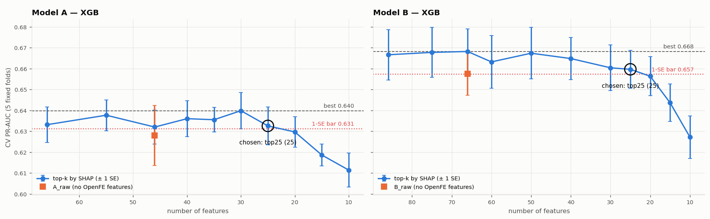
Features: generate, filter, explain, reduce
Rule picked 25 features for model A; 30 kept after a validation check (dropped too much).
Generate
20 OpenFE
features
Filter
screens +
VIF (linear)
Explain
SHAP +
permutation
Reduce
1-SE rule
66 → 30
Design choice — row-wise generators only: OpenFE's group / frequency operators learn from all rows and would leak; formulas were re-implemented so inference recomputes them identically.
Result: debt combined with a stress signal (interest rate, inquiries, delays, credit history) drives risk; generated features earn their place (without them the model falls below the selection bar).
CS611 Assignment 2 · End to end machine learning for loan default prediction
6
Notes:
Model-specific filtering: tree models keep correlated features; the linear model drops near-duplicates and high-VIF features. The one-standard-error rule picks the smallest feature set statistically as good as the best.

Slide 7
Model selection: trees win, extras must earn it
Class weighting
Hyperparameter tuning
Champion = model A
Robustness
+0.005 at best, probabilities inflated → not used
60 Optuna trials: +0.009 (< 0.02 rule) → defaults kept
B scores higher in-time but cannot score new loans (no clickstream); B − A on test not significant
stress tests 8/8; 10% noise −0.004 PR-AUC; stable across seeds
CS611 Assignment 2 · End to end machine learning for loan default prediction
7
Notes:
Rule fixed before training: a change counts only if it adds at least 0.02 cross-validated PR-AUC and more than the fold-to-fold spread. Threshold = maximum F1 on validation (no business cost available). Out-of-time result: PR-AUC 0.619 vs 0.542, bootstrap CI of the difference excludes zero.

Slide 8
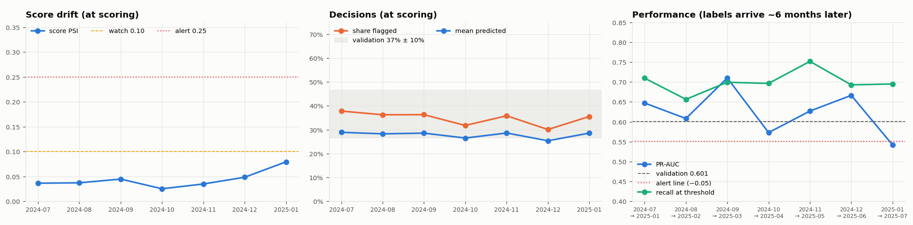
Governance: retraining rules set in advance
Monitor
every month: drift (PSI), data
quality; performance +6 months
Check rules
a trigger must persist
2 consecutive months
Refit / rebuild
every 6 months, or early on a
trigger; rebuild on source change
Gates
tests · PR-AUC ≥ champion − 0.01
calibration · segments
Shadow + approve
1 month in parallel;
risk committee signs
Promote
move @champion alias;
rollback = move it back
the cycle repeats every month
Replay of production 2024-07 → 2025-07
• Inputs stable: every PSI ≤ 0.06
• Score PSI ≤ 0.08; flag rate in band
• One alert: PR-AUC 0.542 for 2025-01 loans — single month → investigate, no refit
• Challenger's clickstream 100% missing → blocked from promotion
• Rollback drill on the registry: restored exactly
Why 2 months: a month holds ~500 loans; its PR-AUC moves several points from sampling alone. Roles: owner, independent validator, approver, platform.
CS611 Assignment 2 · End to end machine learning for loan default prediction
8
Notes:
Monitoring was replayed on the months after training because there is no live data yet. Labels are used only from the date they would arrive, so the performance check is realistically delayed.

Slide 9
Deployment: batch scoring from the registry
Option | Fits when | Verdict
Batch scoring | decision can wait; snapshot features | Chosen — monthly now, daily next
Real-time API | instant decision at application | Later: needs online features
Streaming | decision per event | Not needed: one per loan
In-database / embedded | scoring inside another system | Not needed: extra conversion
3,526
new loans scored in 7 monthly batches, each with a probability, flag and 3 reason codes
identical
deployed predictions vs the tested model; month-by-month data vs the full build
@alias, not files
inference loads models:/…@champion; promote or roll back with no code change
≤ 0.005
Same code everywhere
notebooks → util modules; Airflow tasks call them per month
PR-AUC difference Windows vs Linux (Docker); same decisions
Isolated runtime
pipeline in its own Python env inside the Airflow image; Docker for both
Clean Docker runs from raw data exposed and fixed: Spark memory, CPU limits, a missing system library.
CS611 Assignment 2 · End to end machine learning for loan default prediction
9
Notes:
Batch fits because features are monthly snapshots and the decision can wait a day. A real-time API would need the same features served online at application time.

Slide 10
Challenges, results and what comes next
CHALLENGE → SOLUTION
RESULTS
Dirty raw data
clean to null + flag, every change audited
0.619
out-of-time PR-AUC (baseline 0.542)
Clickstream stops mid-2024
champion without it; challenger kept
70%
of later defaulters caught, flagging ~35% of loans
AutoFE could leak
row-wise formulas only, recomputed at inference
30
features, down from 66, with no loss
No business cost of errors
threshold = maximum F1 on validation
Spark on Windows / Docker
pinned env, explicit memory and cores
NEXT
Daily batches · investigate the 2025-01 cohort · segment calibration (managers, income Q4) · business cost for the threshold · bring the challenger back if clickstream returns
Month-by-month must match
verified identical to the full build
CS611 Assignment 2 · End to end machine learning for loan default prediction
10
Notes:
Close: the model is good, but the bigger result is a pipeline that can be trusted, re-run anywhere, monitored and refreshed by rule.

